Slide 1
Quick Guide to the Transition Phase of the President’s Recovery Priorities
August – November 2017
Ebola don go, leh we make Salone grow!

Slide 2
Contents
Background and overview of the President’s Recovery Priorities
Status of Initiatives to be tracked
Activity Planning
Delivery architecture –President’s Delivery Team, MDAs and Districts Structure
Community ownership and demand

Slide 3
Background and context of the President’s Recovery Priorities
Timeline of the Sierra Leone Recovery and Agenda for Prosperity
2015
2016
2017 and beyond
Ebola Response
24 months
4 months
Transition
Phase
(4 months)
Early Recovery
(6-9 Months)
President’s Recovery Priorities (10-24 months)
Agenda for Prosperity
National Recovery Strategy
Delivering outcomes whilst building capacity

Slide 4
The President’s Recovery Priorities – 4 Months Transistioning Phase
Key Result Areas
Enabling the achievement of over 50% of the 13 Key Result Area targets of the 12-24 months plus increasing local government revenue generation
Sub-initiatives
Targeted for completion across 5 priority sectors across the country
Priority Sectors
Education, Energy, Health, Water, Finance
05
07
08
18
34
Participating MDAs
Ministries of Education, Energy, Health, Water, Finance, Freetown City Council and Western Area Rural District Council (WARD C)
Priority Initiatives
Getting to 100% target completion of selected 10-24 months PRP initiatives, providing further support to selected infrastructure projects in the energy and water sectors and local govt. revenue

Slide 5





PRP Extension Initiatives
Sector
Initiatives
Strengthen national community health worker programme
Strengthen supply chain system
Develop functional national ambulance service
Improve community sanitation (Operation Clean Freetown)
Clear payroll and reallocate teachers
Reduce unapproved schools
Construct 500 furnished classrooms
School feeding programme
Rehabilitate existing Freetown water supply infrastructure and implement pro-poor water supply
Install electricity in schools, hospitals and other institutions and build solar systems (UNOPS)
Establish collection account and sector wide budget
T&D upgrades in Western Area and Wellington Express Line plus Kick-starting the CEC project
30 MW HFO IPP
30 MW HFO Government Owned
14-50 MW Grid Solar
Increase property tax base
Improve management of property tax with focus on tax efficiency, effectiveness and equity
Enhance revenue mobilization strategy

Slide 6
The Transition Phase continues with …..
  Committed top leadership: His Excellency the President remains committed to driving delivery
Prioritisation: focus on 5 priority sectors
  Concrete targets: targets are concrete, measurable and achievable
  Decentralisation: implementation and accountability continues at district, chiefdom and section levels and takes into account the de-amalgamation which created 41 new chiefdoms
Robust performance management: weekly activity tracking, tracking progress against KPIs, District and Central sector meetings, and active problem-solving of issues as they arise continues
  Transparency and accountability: clear and objective reporting of progress across all sectors
  Sustainable empowerment: transitioning of PDT process & systems across all levels of MDAs including Ministry of Local Government & Rural Development

Slide 7
Extension Initiatives: December 2017 forecast
60% of the Initiatives will meet 100% of their targets by Dec’17
Breakdown of the 15 Initiatives RAG rating
Sector
Initiative
Expected progress as at July ‘17
Expected progress as at Dec ‘17
Health
Strengthen national community health worker programme
Develop functional national ambulance service
Improve community sanitation (Operation Clean Freetown)
20%
100% of target met
Education
Clear payroll and reallocate teachers
Reduce unapproved schools
Construct 500 furnished classrooms (phase 2)
School feeding programme
60%
Energy
Install electricity in hospitals and other institutions and build solar systems (UNOPS)
30 MW HFO (Government Owned)
50%-99% of target met
53%
Health
Strengthen supply chain system
40%
Energy
Establish collection account and sector wide budget
30 MW HFO IPP
50 mw Solar IPP
128 MW Western Area Generation Project (CEC)
0%-49% of target met
27%
Water
Rehabilitate existing Freetown water supply infrastructure and implement pro-poor water supply
*Excluding Finance initiatives, forecast as at 26th September 2017

Slide 8
Planning Timeline (MOHS, MEST, MOWR, GOV,MOE)
Extension Phase Activity Plan Timeline
Aug
SEPT
Plan development
13
20
27
3
10
17
24
Unlocked plans provided to sectors
Mon, 14th
IWGs (MOHS, MEST,MOWR, GOV) update existing activity plans
Adjusted milestones submitted to PDT for review
Mon, 21st
District and CDT review of plans
Tues, 22nd
Comments provided to sectors (from PDT & Districts)
Mon, 28th
Final drafts submitted by sectors
Fri, 1st
Final review (with amendment, as necessary)
Thurs, 7th
Plans locked
Fri, 8th
Tracking commences
Tues, 12th

Slide 9
Delivery Structure of the Transition President's Delivery Team
Core responsibility
** Reduced Direct support personnel from
Plan, oversee, and report to Presidential and Ministerial Delivery Forum
  Central MDAs
  Ministers, Commissioners
  KRA Leads, Initiative and sub-initiative owners
Presidential Delivery Team
  Sector Transition Facilitators
  Central Delivery
  Team support
  all functions
Districts implement and report to Central MDAs
  District MDAs
  District Councils for devolved functions
  District-based implementing partners
  Private Sector participants
  District Transition Facilitators
Monitor and evaluate
  Central and District MDAs
  Paramount Chiefs
  District Councils
Community ownership is critical to success

Slide 10
Delivery structures within the MDAs
Minister
MDA Delivery Team Composition:
Minister (or designate)
KRA Leads
Priority Initiative Owners
M&E Officer
Comms Officer / PRO
Sector Transition Facilitator
KRA 1 Lead
TF
KRA 2 Lead
Priority initiative working groups:
Initiative Working Group Composition:
Priority Initiative Owner (internal to MDA)
Sub-initiative owners from responsible MDAs
Other technical support, as needed
Implementing partner(s)
Relevant development partner(s)
Other stakeholders
Sector Transition Facilitator
TF
Transition Facilitator (SF)
Works directly with MDA leadership, including Minister, to drive delivery
Supports MDA KRA Lead(s) and works with the Priority Initiative Owners

Slide 11
Delivery structures at District Level
District Delivery Forum
District Delivery Forum:
Council Chairman (co-chaired by Mayor, where applicable)
Chief Administrator
Heads of District MDAs
District Transition Facilitator
DTF
District Sector Meeting
District Sector Meeting
District Sector Meeting
District Sector Meeting Composition:
Head of District MDA
M&E Officer
Sector representative from District Council
Implementing Partners
District Transition Facilitator
DTF
District Transition Facilitator
Supports District Council in its coordination and oversight role
Supports District Council and MDAs for monitoring & evaluation and data analysis related to the PRPs
Works with District Office and Paramount Chiefs to support community-level engagement

Slide 12
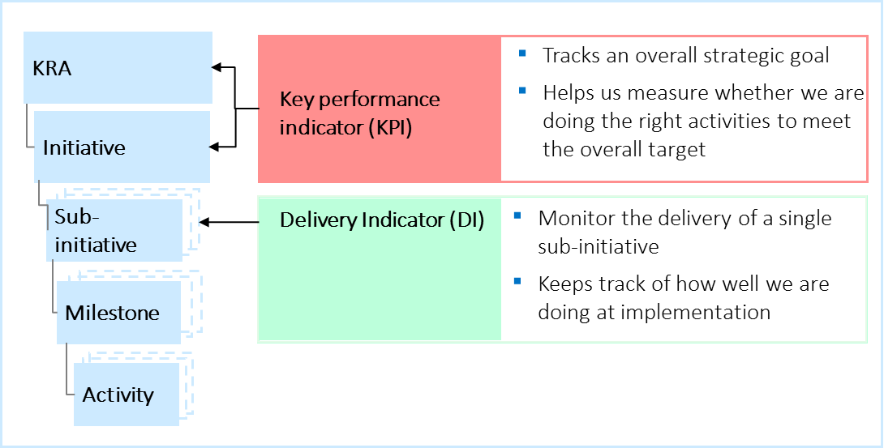
Bi-Weekly - Implementation of initiatives tracked for completion, performance and accountability
Each priority initiative and sub-initiative team have selected performance metrics…
… which are reported on regularly to track progress
Key Performance Indicators (KPIs) and Delivery Indicators (DIs) monitor success at the KRA through sub-initiative levels
Priority initiatives and sub-initiatives show weekly progress through trackers reported at Presidential and Ministerial Delivery Forums
Implementation of detailed activity plans updated in Activity Tracker on a bi-weekly basis

Slide 13
Bi-Weekly implementation rhythm designed to report progress and to identify, escalate and resolve issues
  MDAs:
    Implement activities at District and Central level, directly or via Implementing Partners
    Update activity trackers to report implementation
    Resolve/escalate issues affecting implementation
Additional
mechanisms for issues identification and resolution:
MDA Initiative Working Groups & District Sector Meetings
Bi-Weekly sessions held before & after Activity Tracker submission
Activity tracker updates submitted by MDAs bi-weekly on
Tues, 5pm
  Daily District sector specific issues log
  Fortnightly Sector Deep Dives to review milestones missed
  Bi-Weekly
  implementation
  rhythm
  PDT aggregates MDA submissions to collate Milestones hit/missed and create Delivery Forum outputs (e.g. milestone summary and issues for resolution)
  Post Delivery Forum, Sector Action Trackers produced and follow-up happens via:
    HE meetings
    Bi-lateral MDA meetings
    Other actions
Presidential/ Ministerial Delivery Forum
Thurs, 2pm

Slide 14
Chiefdom and section-level monitoring during transition phase impacted by creation of 41 new chiefdoms
Transition Phase Section Targets ( to be updated)
Delivery Indicators to be made available at Section-level
Energy: 1
Education: 2
Health: 3
Additional 41 newly created chiefdoms increases monitoring from 149 to 190 chiefdoms
*As at September 72% of sections had 2 or more indicators to monitor

Slide 15
District Breakdown of Extension Initiatives to be tracked

Slide 16







Communication Strategy: We are using online, social and traditional media to keep citizens and stakeholders informed
239,000 reached through Facebook
195,000 reached through WhatsApp This Week in Recovery
“…the presence of a delivery unit is not the only way to drive delivery and demonstrate leadership commitment…citizen feedback is widely used in many countries. In fact, the wide use of social media and technology has further amplified the pressure for political leaders and governments to deliver”
“Ministers share experience of leadership for delivery” - World Bank Feature Article June 2014
>700
Twitter followers
presidentsrecoverypriorities.gov.sl
Dedicated PRP website
News and updates on the PRP across various radio stations
Regular articles in the printed press

Slide 17



The PRP monitoring mechanisms to ensure effective implementation of the PRPs
GoSL monitoring mechanisms
  PDT
  MDAs
  District Councils
  Paramount / Section Chiefs
External monitoring mechanisms
  SABI consortium
  Independent evaluators

